Slide 1

Physical Storage Organization and File Structures
Database Management System | Storage Structures, Indexing and Query Optimization
Course: Database Management System (DBMS) | Chapter: Storage Structures, Indexing and Query Optimization | Program: B.TECH-CSE, B.TECH CSE - CYBER SECURITY, B.TECH CSE - DATA
DISCOVER · LEARN · EMPOWER
Notes:
Welcome everyone to today's lecture on the physical layer of database management. We are diving deep into how data is actually stored on disks, which is the foundation of all performance. As Chandigarh University students, you will learn to bridge the gap between logical queries and physical reality. Let us begin by understanding why this matters for system scalability.

Slide 2
Course Outcomes
SLIDE 2 / 14
Course Outcome
CO | BT LEVEL | DESCRIPTION
CO1 | BT2 | Explain database architecture, relational model concepts and formal query language foundations including relational algebra and relational calculus.
CO2 | BT3 | Apply relational algebra, relational calculus and SQL constructs to formulate correct and efficient database queries.
CO3 | BT4 | Analyze functional dependencies and design normalized relational schemas up to 5NF ensuring lossless join and dependency preservation.
CO4 | BT4 | Analyze transaction schedules and concurrency control mechanisms to determine serializability, recoverability and correctness.
CO5 | BT5 | Evaluate storage structures, indexing strategies and query optimization techniques for performance, scalability and reliability.
Chandigarh University
2 / 14
Notes:
Today's session directly addresses two critical course outcomes. First, we explain the architecture and how it supports the relational model foundations you learned earlier. Second, and most importantly, we evaluate how storage structures and file organization impact the performance and reliability of your database systems. Mastering this allows you to design scalable solutions.

Slide 3
Learning Objectives
SLIDE 3 / 14
Learning Outcomes
1
Analyze the distinction between logical and physical storage organization in DBMS.
2
Evaluate the impact of file organization types on data retrieval efficiency.
3
Calculate storage requirements and I/O costs for different file structures.
4
Critique the trade-offs between sequential, heap, and indexed file organizations.
5
Design optimal file structures for specific query workload scenarios.
Chandigarh University
3 / 14
Notes:
By the end of this lecture, you will be able to analyze how logical requests translate to physical disk operations. You will evaluate why a sequential file might be faster than a heap file for certain queries. We will calculate actual storage costs to understand the financial and performance implications of your design choices.

Slide 4
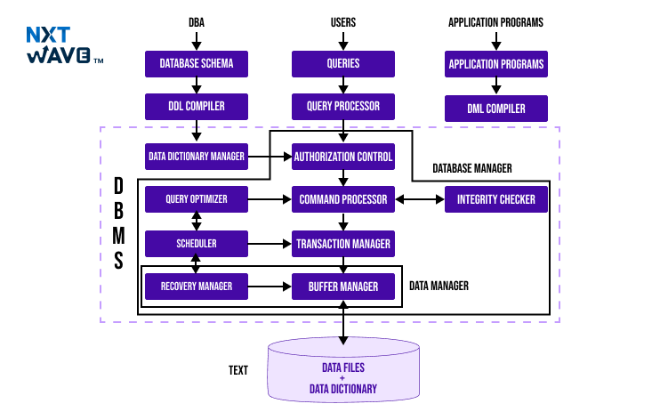
Lecture
SLIDE 4 / 14
Logical vs Physical Storage Distinction
1
Logical storage defines how data is viewed by users and applications.
2
Physical storage defines how data is actually stored on disk blocks.
3
Data independence allows logical changes without affecting physical storage structures.
4
The DBMS acts as a translator between logical requests and physical blocks.
5
Physical storage directly determines I/O operations and overall system speed.
6
Understanding this separation is crucial for optimizing query performance effectively.
Understanding the Structure of DBMS: Components, Architecture, and Models
Chandigarh University
4 / 14
Notes:
Think of logical storage as the menu in a restaurant, while physical storage is the kitchen where the food is prepared. The DBMS is the waiter who translates your order into kitchen instructions. If the kitchen is disorganized, even the best menu will result in slow service. This separation allows us to change the physical layout without breaking the application.

Slide 5
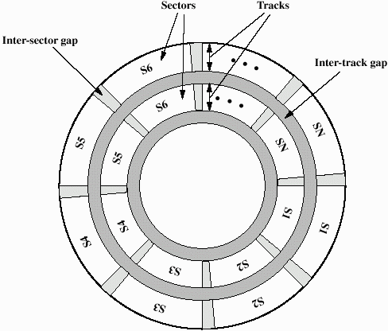
Lecture
SLIDE 5 / 14
Disk Block and Page Concepts
1
Disk blocks are the smallest unit of data transfer between disk and memory.
2
A page is a contiguous set of blocks allocated for a specific file.
3
Block size typically ranges from 4KB to 64KB in modern systems.
4
Larger blocks reduce I/O overhead but may waste internal storage space.
5
The number of records per block depends on record size and block size.
6
Efficient block utilization is key to minimizing disk access time.
Source: faculty.etsu.edu
Chandigarh University
5 / 14
Notes:
Imagine a disk block as a truck delivering packages. If the truck is too small, you need many trips for few items. If it is too large, you waste fuel carrying empty space. A standard block size of 4KB is a common trade-off. We must calculate how many records fit in a block to optimize our storage strategy.

Slide 6
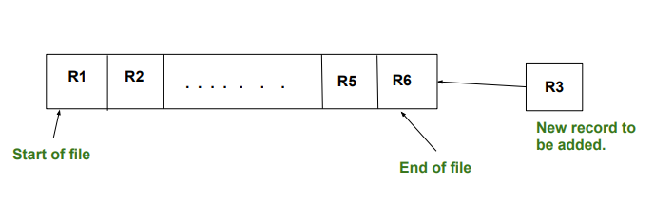
Lecture
SLIDE 6 / 14
Heap File Organization Explained
1
Heap files store records in no particular order of insertion or key.
2
New records are appended to the end of the file sequentially.
3
Insertion is extremely fast as no sorting or searching is required.
4
Deletion requires scanning the entire file to find the specific record.
5
Search operations require a full table scan for any query condition.
6
Heap files are ideal for temporary data or bulk loading operations.
Source: media.geeksforgeeks.org
Chandigarh University
6 / 14
Notes:
A heap file is like a pile of papers on a desk where you just drop new items on top. Adding a new record is instant because you don't need to sort anything. However, finding a specific record is like searching through a messy pile; you must check every single paper. This makes heap files terrible for frequent lookups but excellent for rapid bulk loading.

Slide 7
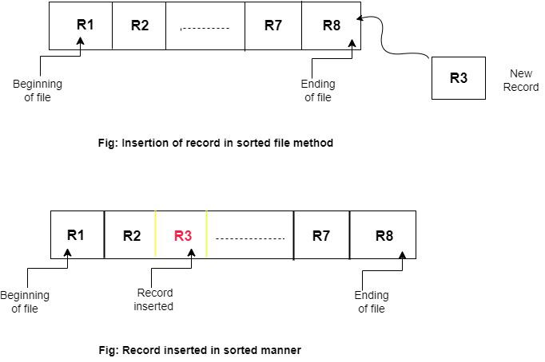
Lecture
SLIDE 7 / 14
Sequential File Organization
1
Records are stored in a sorted order based on a search key.
2
Insertion requires shifting records to maintain the sorted order.
3
Search operations are highly efficient using binary search algorithms.
4
Deletion is efficient but may leave gaps requiring periodic reorganization.
5
Ideal for batch processing and reporting where sorted output is needed.
6
Performance degrades significantly with frequent insertions and deletions.
Source: media.geeksforgeeks.org
Chandigarh University
7 / 14
Notes:
In a sequential file, records are like books on a shelf arranged by author. Finding a book is fast because you can use binary search to jump to the middle. However, adding a new book requires moving all subsequent books to make space. This makes sequential files perfect for generating sorted reports but poor for high-volume transactional updates.

Slide 8
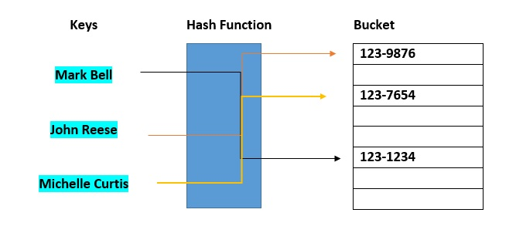
Lecture
SLIDE 8 / 14
Hash File Organization Basics
1
Records are placed in buckets based on a hash function of the key.
2
Direct access allows O(1) retrieval for exact key match queries.
3
Hash collisions occur when two keys map to the same bucket.
4
Overflow chains handle collisions by linking records in a linked list.
5
Performance depends heavily on the quality of the hash function used.
6
Not suitable for range queries or sorting operations effectively.
Source: www.databricks.com
Chandigarh University
8 / 14
Notes:
Hash files work like a library where each book has a specific slot number calculated by a formula. If you know the exact key, you go straight to the slot in constant time. However, if two books map to the same slot, they form a chain. This method is incredibly fast for exact matches but fails completely if you need to find all books between 'A' and 'M'.

Slide 9
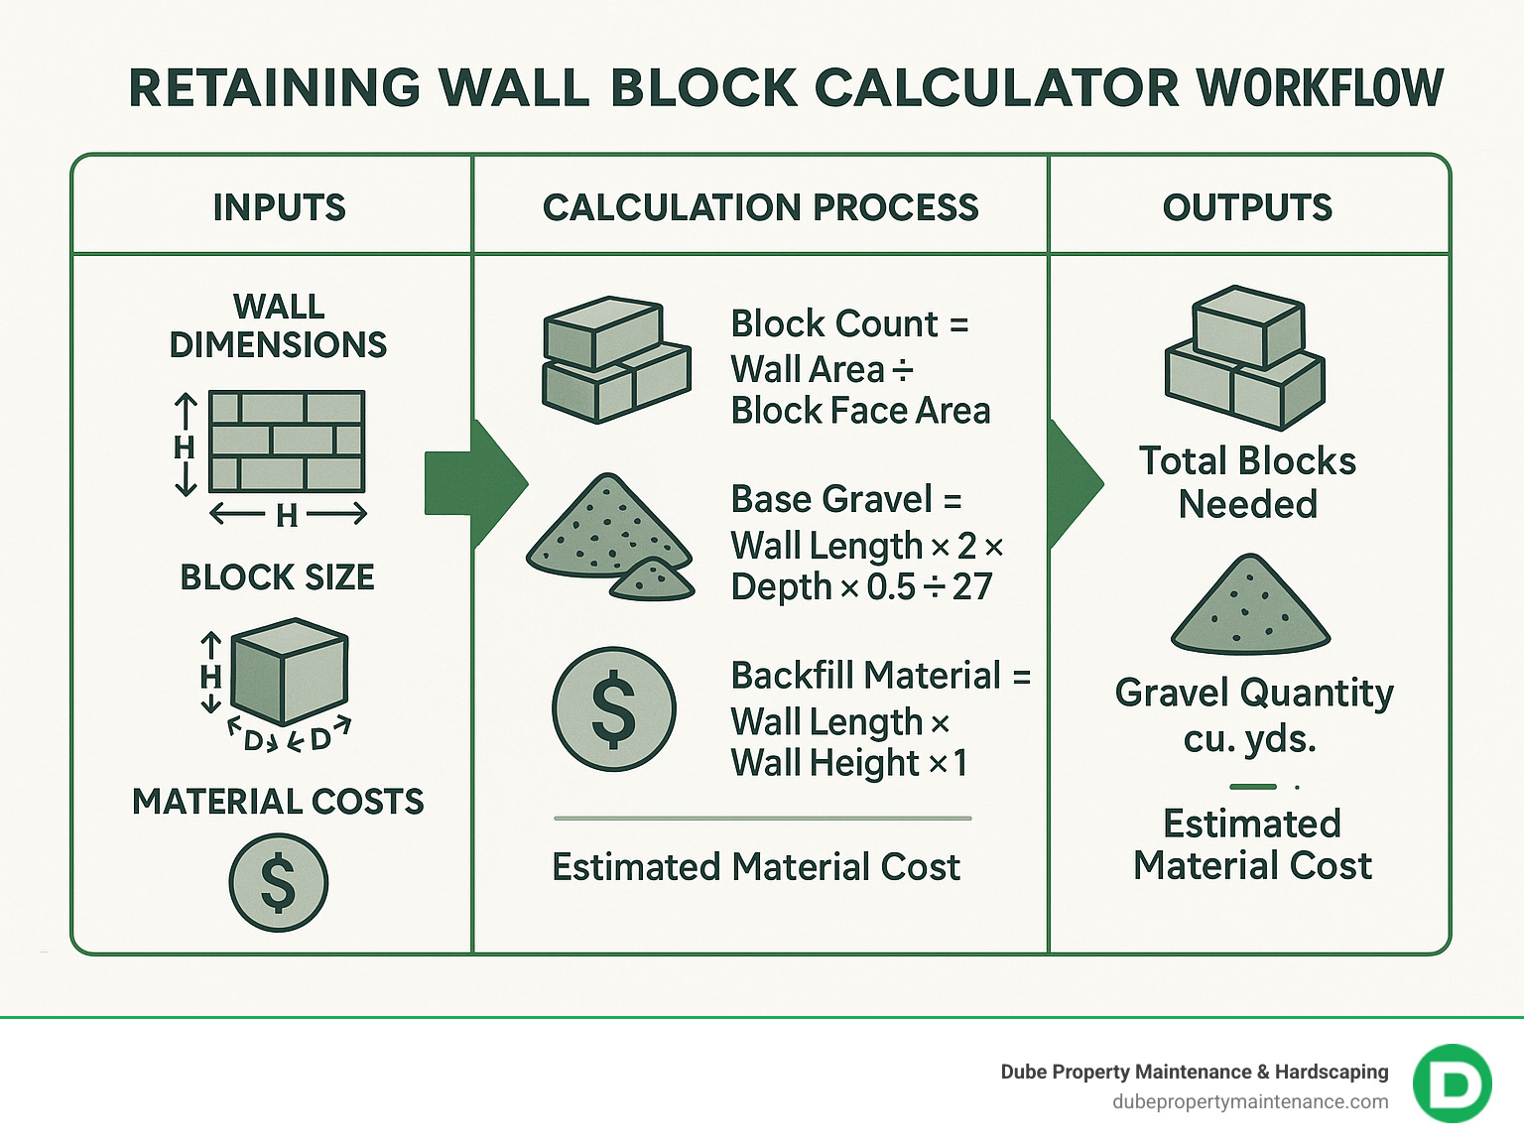
Worked Example
SLIDE 9 / 14
Block Utilization
GOVERNING EQUATION
Given: Block size = 4096 bytes, Record size = 100 bytes
CALCULATE
Number of records per block = floor(4096 / 100).
RESULT
40 records fit per block with 96 bytes wasted.
OVERHEAD
4 bytes per block for block header and control info.
TOTAL CAPACITY
10000 records require 251 blocks for storage.
EFFICIENCY
97.5% of space is used for actual data storage.
Source: images.bannerbear.com
Chandigarh University
9 / 14
Notes:
Let's do a quick calculation. If your block is 4096 bytes and each record is 100 bytes, you can fit exactly 40 records. This leaves 96 bytes of wasted space per block. For 10,000 records, you would need 251 blocks. This shows that while we lose some space, the overhead is minimal, and we maximize I/O efficiency by packing as many records as possible.

Slide 10
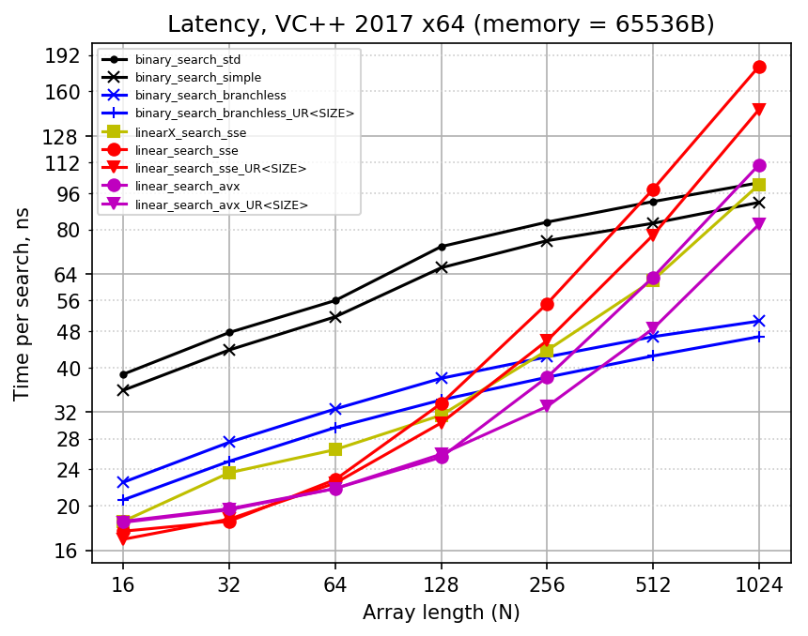
Lecture
SLIDE 10 / 14
I/O Cost Analysis for Queries
1
I/O cost is the primary metric for evaluating file organization performance.
2
Sequential scan cost equals total blocks in the file.
3
Binary search cost equals log base 2 of total blocks.
4
Hash lookup cost is constant regardless of file size.
5
Minimizing I/O operations directly improves query response time.
6
Cost models help choose the best file structure for specific workloads.
Source: dirtyhandscoding.wordpress.com
Chandigarh University
10 / 14
Notes:
The cost of a query is measured in disk I/O operations. Scanning a file with 10,000 blocks takes 10,000 I/Os. Using binary search reduces this to about 14 I/Os. Hash lookups take just 1 I/O. As your data grows, the difference between these methods becomes massive. We must always choose the structure that minimizes these I/O costs for our specific query patterns.

Slide 11
Lecture
SLIDE 11 / 14
Common Pitfalls in File Design
1
Choosing sequential files for high-update transactional systems causes bottlenecks.
2
Ignoring hash collisions leads to severe performance degradation over time.
3
Using fixed block sizes without considering record size variations wastes space.
4
Failing to reorganize sequential files leads to excessive fragmentation.
5
Over-indexing increases write overhead and storage requirements unnecessarily.
6
Neglecting buffer pool management reduces the effectiveness of any structure.
Chandigarh University
11 / 14
Notes:
A common mistake is using sequential files for a system with thousands of daily updates, which will slow down to a crawl. Another pitfall is ignoring hash collisions; if your hash function is poor, your fast lookups turn into slow scans. You must also consider that fixed block sizes might waste space if your records vary greatly in length. Always profile your workload before choosing a structure.

Slide 12
Lecture
SLIDE 12 / 14
Impact on Query Optimization
1
Query optimizers rely on file organization statistics to choose execution plans.
2
Statistics include record count, block count, and key distribution.
3
Poor file organization forces the optimizer to choose suboptimal paths.
4
Accurate statistics enable the optimizer to select the most efficient access path.
5
File organization dictates whether a full scan or index scan is used.
6
Understanding physical layout is essential for manual query tuning.
Chandigarh University
12 / 14
Notes:
The query optimizer is like a GPS that needs accurate maps to find the fastest route. If your file organization is poor, the optimizer might take a detour, choosing a full scan when an index would have been faster. It relies on statistics like the number of blocks and key distribution to make these decisions. Without understanding the physical layout, you cannot effectively tune your queries.

Slide 13
Lecture
SLIDE 13 / 14
Key Takeaways
1
Physical storage organization directly determines database performance and scalability.
2
Heap files offer fast inserts but slow searches, while sequential files do the opposite.
3
Hash files provide constant-time access for exact matches but fail at range queries.
4
I/O cost is the critical metric for evaluating and comparing file structures.
5
Proper file selection requires analyzing the specific workload and query patterns.
Chandigarh University
13 / 14
Notes:
To summarize, the physical layout of your data is the foundation of performance. Heap files are great for speed of entry, sequential files for sorted access, and hash files for instant lookups. Always measure your success by I/O cost, not just logical correctness. Finally, there is no single best structure; you must match the file type to your specific workload.

Slide 14
Lecture
SLIDE 14 / 14
References
1
Fundamentals of Database Systems — Ramez Elmasri & Shamkant B. Navathe
2
Database System Concepts — Silberschatz, Korth & Sudarshan
3
Database Management Systems — Raghu Ramakrishnan & Johannes Gehrke
4
Oracle/MySQL Documentation — Oracle
Chandigarh University
14 / 14
Notes:
For further reading, I highly recommend the textbooks by Elmasri and Navathe, as well as the classic by Silberschatz. Ramakrishnan's book provides excellent practical insights into database management systems. Finally, always consult the official Oracle and MySQL documentation for the latest implementation details. Thank you for your attention.

